Slide 1
Lecture Objectives
popen()
M4/Autoconf
SCM
Flex

Slide 2
popen()
popen, pclose - pipe stream to or from a process
See the man page for details
You will need to use this in HW3 to get output from your gawk program back into your C++ program.
I have uploaded an example of its use to ELearning

Slide 3
M4
GNU M4 is a macro processor that copies its input to the output expanding macros as it goes. At its most basic, it can be used for simple embedded text replacement. If m4 receives the input:
define(AUTHOR, William Shakespeare)
A Midsummer Night's Dream
by AUTHOR
then it outputs
A Midsummer Night's Dream
by William Shakespeare

Slide 4
autoconf
Autoconf is:
An extensible package of M4 macros
Produces shell scripts to automatically configure (not build) software source code packages.
Adapts the packages to many UNIX-like systems without manual user intervention.

Slide 5
autoconf
What needs adapting between systems?
Detecting a compiler
Testing for existence of header files
Testing for existence of required libraries
Performing custom tests
Configuring for compatibility

Slide 6
autoconf
At the end of the day, as typically distributed with UNIX source code, autoconf:
creates a .configuration shell script
Executing the .configuration script performs the script operations on your current UNIX OS (Mac, Linux, Solaris, etc).
A Makefile is generated that is specific to the build/install using YOUR specific UNIX system.
Other toolchains are involved that rely on M4/autoconf (automake, libtool)

Slide 7
autoconf
Why is it important?
A lot of useful code is available in source form. As described earlier, you may often download that source using wget or an SCM package like git.
Understanding autoconf’s configuration script and the the --prefix option allow you to ready the build environment for your specific UNIX system.
Understanding the make, make test, and make install targets allow for compilation/testing/installation of the downloaded source in an environment where you may not have root access.

Slide 8
SCM
Revision control, also known as version control and source control (and an aspect of software configuration management), is the management of changes to documents, computer programs, large web sites, and other collections of information.
There are several very common packages that people use:
RCS/CVS (Old school)
git (http://en.wikipedia.org/wiki/Git_(software))
subversion/SVN (http://en.wikipedia.org/wiki/Apache_Subversion)

Slide 9
SCM
At the end of the day, it is important to know about git and have the ability to clone a project, revert to any specific version of that project, and then build and use that project.
For this course, it is left as an exercise to learn how to create and use your own git (or other) repository.

Slide 10
Formal Langages
Formal Languages:
The field of formal language theory studies primarily the purely syntactical aspects of such languages—that is, their internal structural patterns. Formal language theory sprang out of linguistics, as a way of understanding the syntactic regularities of natural languages.
In computer science, formal languages are used among others as the basis for defining the grammar of programming languages and formalized versions of subsets of natural languages in which the words of the language represent concepts that are associated with particular meanings or semantics.

Slide 11
Formal Languages
Regular Language:
In formal language theory, a Regular Language is a formal language that can be expressed using a regular expression.

Slide 12
Regular Expressions
Regular Expression
In formal language theory, a regular expression (abbreviated regex or regexp) is a sequence of characters that forms a search pattern.
Regular expression are the simplest class of formal languages. Read up on the full text here:
http://en.wikipedia.org/wiki/Regular_expression#Formal_definition

Slide 13
Regular Expressions
A regular express pattern is a description that tries to match a target string. For instance, from the bash command line:
ls -al myprog*
Matches files with names like:
myprog1.cc
myprog1.o
myprog1.P
myprog1

Slide 14
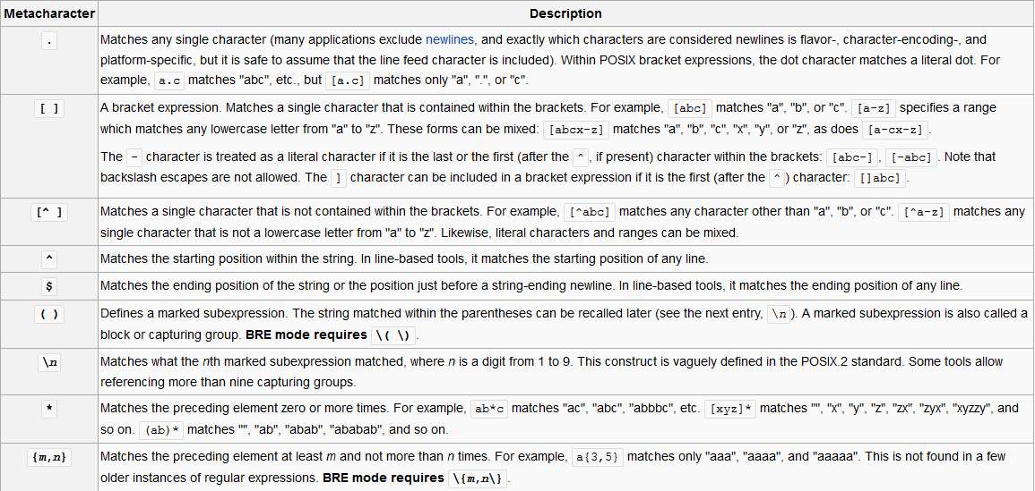
Regular Expressions
Syntax:
A regexp pattern matches a target string.

Slide 15
Regular Expressions
Syntax:
A regexp pattern matches a target string.
Case 1: characters match characters
abc
matches:
abcdef
abcd
abc

Slide 16
Regular Expressions
Case 2: the . matches a single character
.a
matches:
babcdef
cabcd
fgabc

Slide 17
Regular Expressions
Case 3: the [abc] any single character that is a, b, or c
[cmf]an
matches:
can, man, fan
But not:
dan, ran, pan

Slide 18
Regular Expressions
Go through the tutorial at this site:
http://regexone.com/
You should be able to match any of the patterns in this tutorial. Further, when done, you should understand all the patterns in the previous table titles "Regular Expressions".

Slide 19
Finite State Machines
A finite-state machine (FSM) or finite-state automaton (plural: automata), or simply a state machine, is a mathematical model of computation used to design both computer programs and sequential logic circuits.
It is an abstract machine that can be in one of a finite number of states. The machine is in only one state at a time; the state it is in at any given time is called the current state. It can change from one state to another when initiated by a triggering event or condition; this is called a transition. A particular FSM is defined by a list of its states, and the triggering condition for each transition.
Considered as an abstract model of computation, the finite state machine is weak; it has less computational power than some other models of computation such as the Turing machine. (who has seen the movie "The Imitation Game"?)

Slide 20
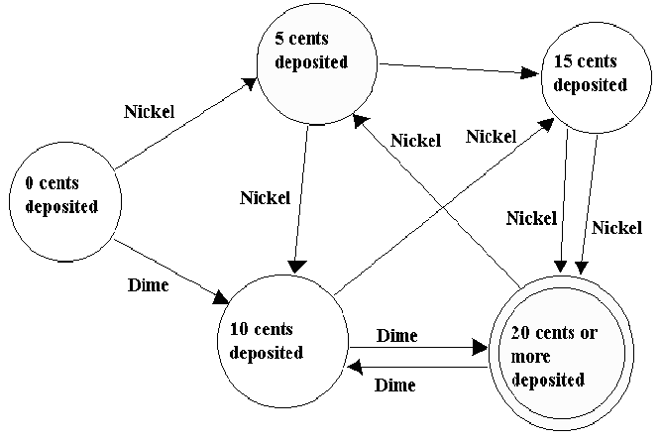
Finite State Machines

Slide 21
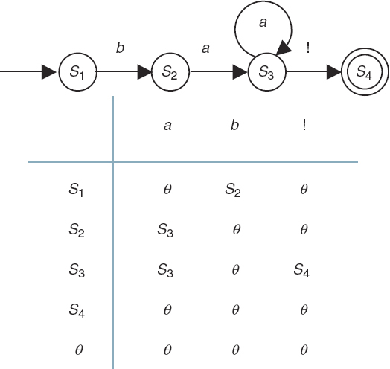
Finite State Machines

Slide 22
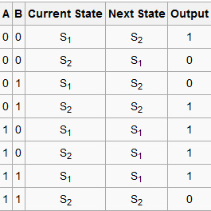
Finite State Machines

Slide 23
Finite State Machines
Why do we care about finite state machines?
Because finite state machines (sometimes called finite state automata) recognize or generate regular languages. Precisely those that are specified by regular expressions
So... Finite State Machines can be used to efficiently implement regular expressions.

Slide 24
Formal Languages
Again... a Regular Language:
In formal language theory, a Regular Language is a formal language that can be expressed using a regular expression.
Alternately:
A Regular Language can be defined as a language recognized by a finite automaton or a Finite State Machine (FSM).

Slide 25
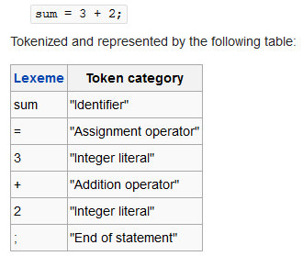
Lexical Analysis
In computer science, lexical analysis is the process of converting a sequence of characters into a sequence of tokens.
A token is a structure representing information that explicitly indicates its categorization.
Lexical analysis forms the first phase of a compiler frontend in modern processing,^{[a]} and is generally done in a single pass.

Slide 26
Lexical Analysis
A lexical analyzer is sometimes called a lexical scanner or just scanner. Its propose is to perform lexical analysis.
Basic Principle:
When a lexical scanner is run, it analyses its input (from stdin or from a file) looking for strings which match any of its patterns.
When a match is determined, it performs certain actions that usually result in a token being generated. Tokens often have "meta-information" associated with them. Ex:
Token: <Identifer>
Meta-Info: the Idenitifer is "myVar1";

Slide 27
Lexical Analysis
With the info to the left, the input is given. The matches are shown under the "Lexeme" column and the matched category (tokens) are shown in the right.
The "Action" may be to output an integer the specifies the specific category (maybe defined by an enum) and to possibly store meta-information about the token (the "identifier" name or the "integer literal" value).

